Slide 1
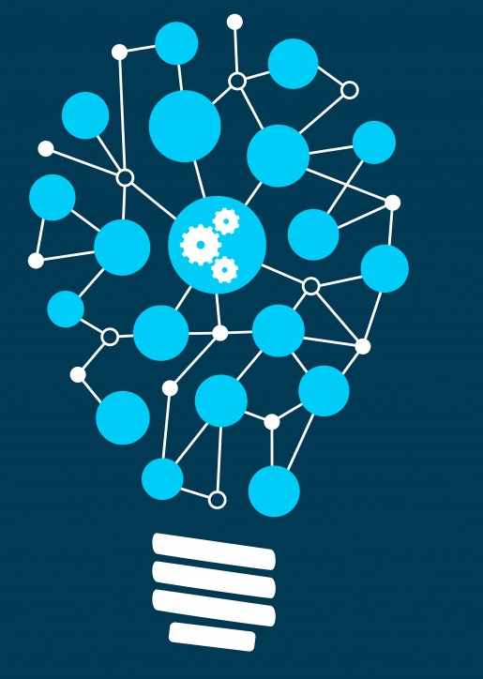
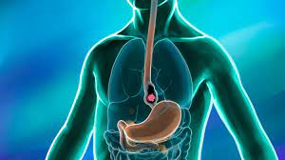
Machine Learning to diagnose Oesophageal Cancer
Project 4 group:
Robert Franklin
Brianna O’Connor
Marisa Duong
21 March 2023
Notes:
MARISA

Slide 2
Table of contents
01 | Introduction | 3
02 | Data workflow | 5
03 | Our ML models | 14
04 | Front end: Streamlit | 21
05 | Limitations & Future Work | 23
Notes:
MARISA

Slide 3

Introduction
1
Notes:
MARISA

Slide 4
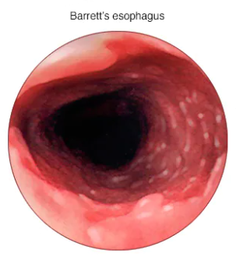
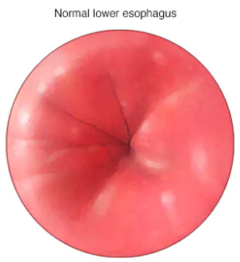

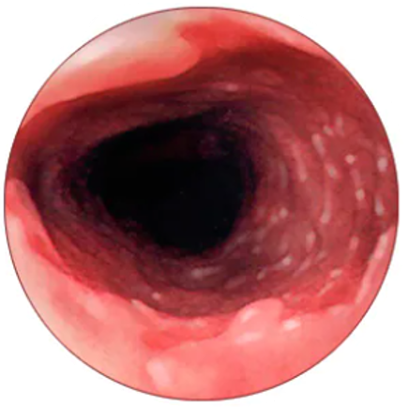
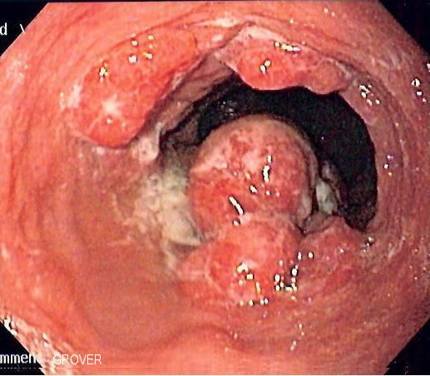
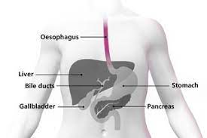
Introduction: Oesophageal cancer
Barrett’s oesophagus
Oesophageal cancer
Healthy
Goal: Build Machine Learning models
Input: clinical data (age, sex, bmi)
and wet lab data (protein levels)
Output: predict Oesophageal cancer
Notes:
MARISA

Slide 5
Data workflow
2
Notes:
MARISA

Slide 6
Approach
01
Data source and visualisations
02
ETL
03
Build ML models
04
Front-end product
03
Published peer-reviewed journal article (supplementary data)
Tableau
Extraction: csv
Transform: Python (Jupyter Notebooks), Pandas DataFrame
Load: -
Logistic regression
and supervised machine learning models
Streamlit
https://cancer-risk.streamlit.app/
Notes:
MARISA

Slide 7
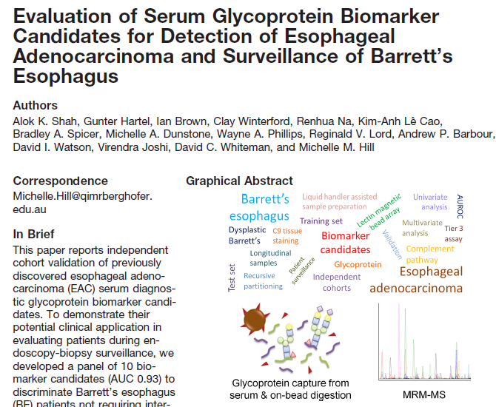
Data source
https://doi.org/10.1074/mcp.RA118.000734
Notes:
MARISA

Slide 8
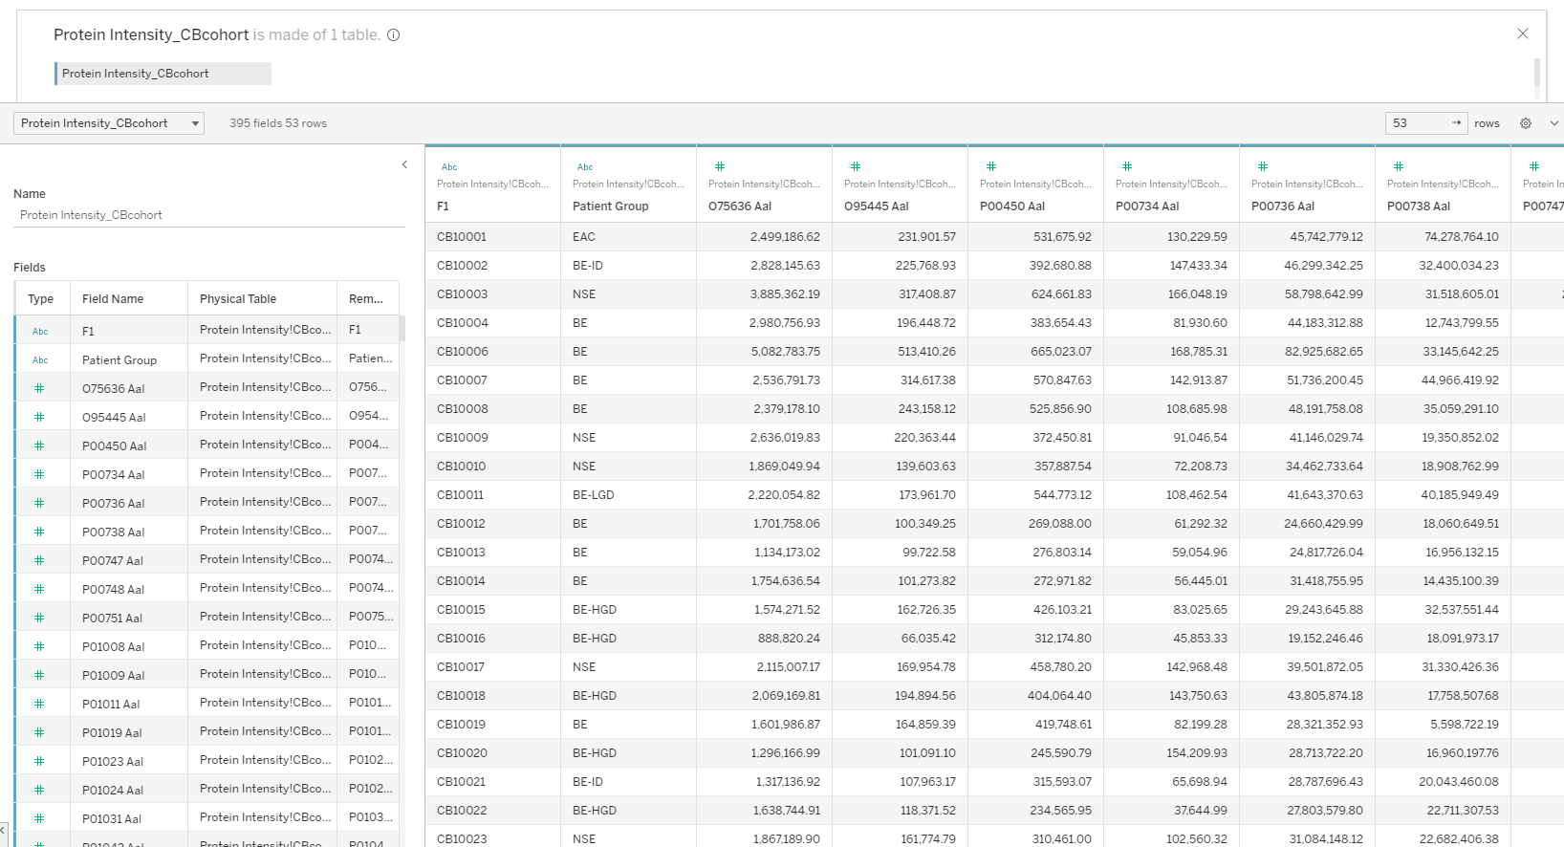
Data
Patient
Notes:
MARISA

Slide 9
Data
Patient group
Notes:
MARISA

Slide 10
Data
Wet lab protein data
Notes:
MARISA

Slide 11
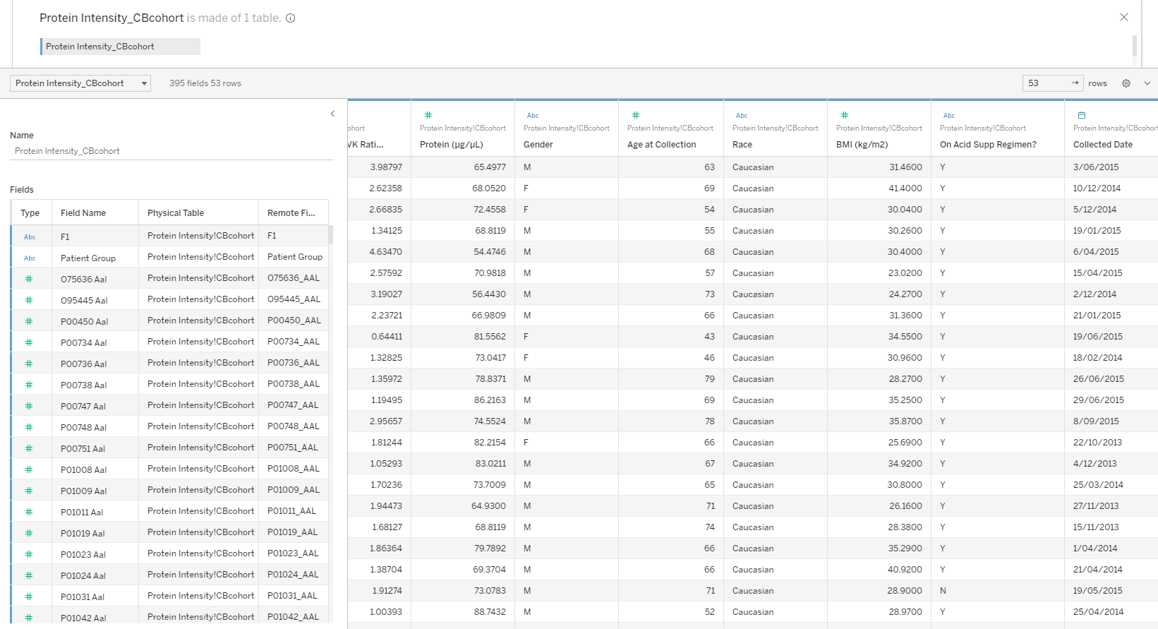
Data
Clinical data
Notes:
MARISA

Slide 12
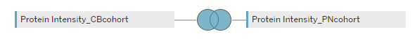
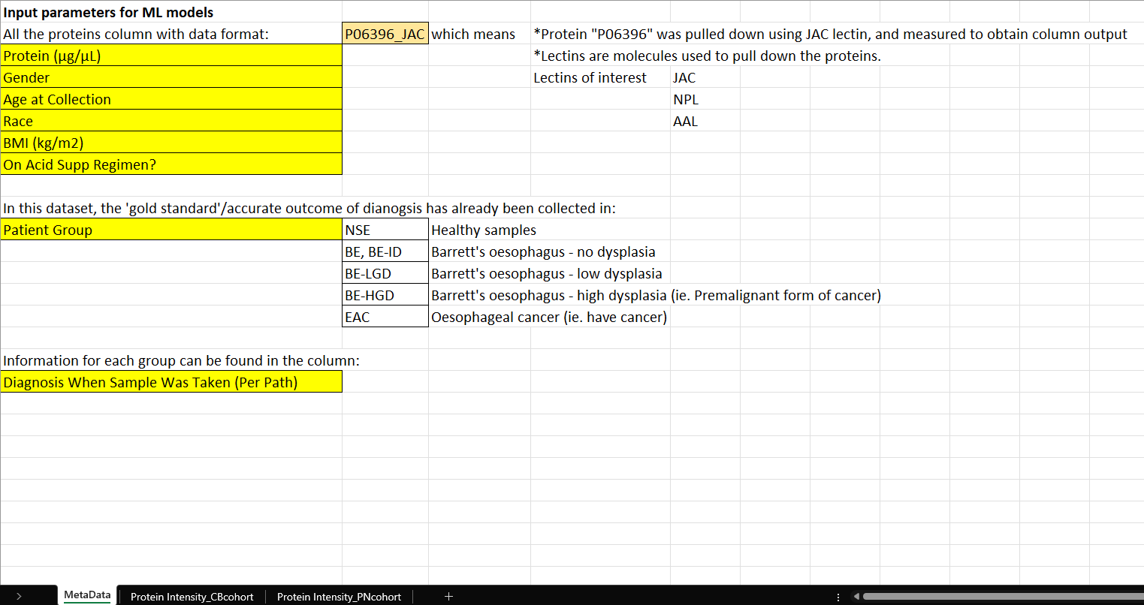
Data
53 rows
253 rows
Notes:
MARISA

Slide 13
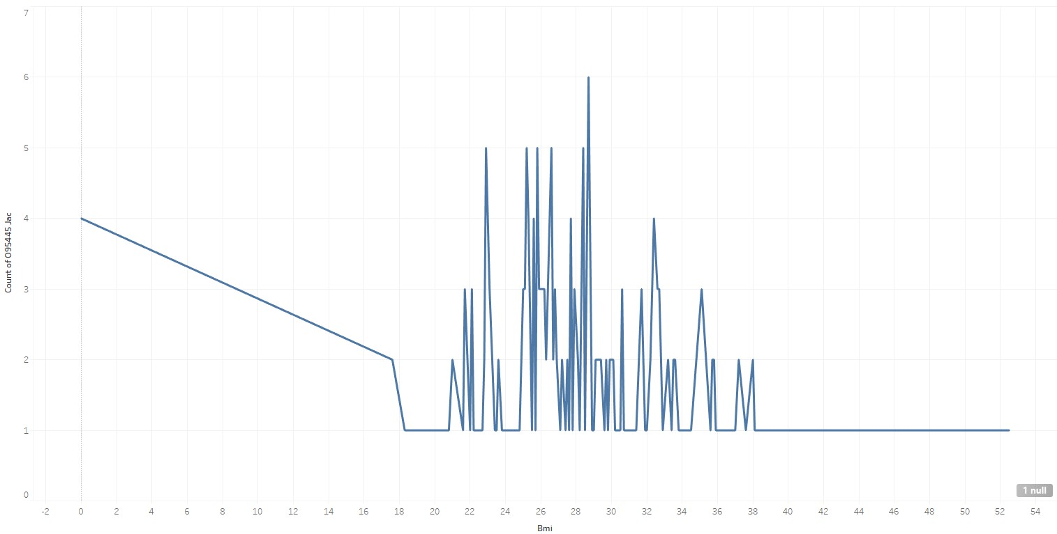
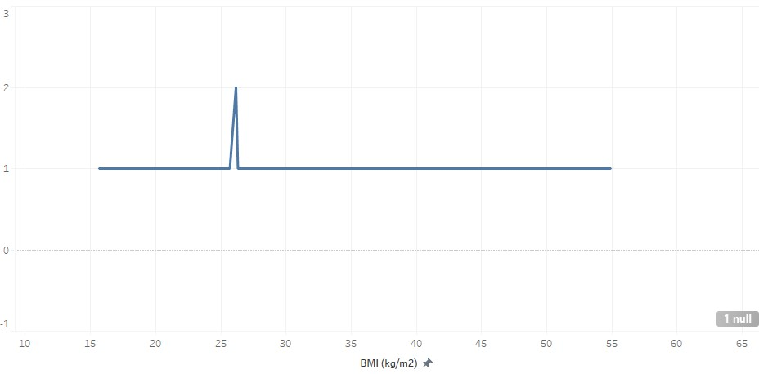
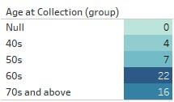
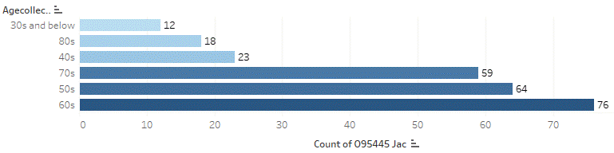
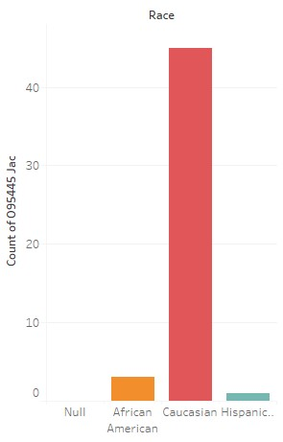
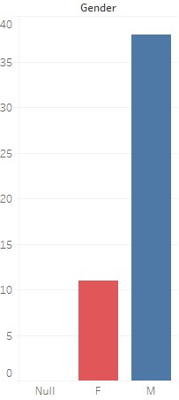
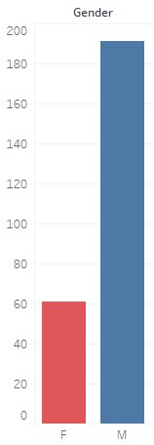
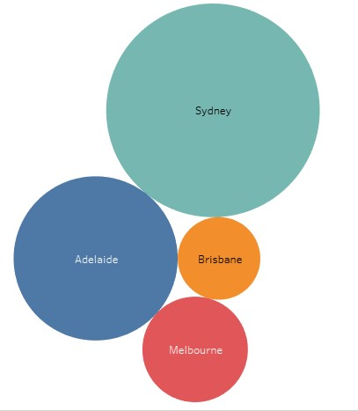
Tableau visualisations
BMI
53 rows
253 rows
BMI
Notes:
MARISA

Slide 14
Our ML models
3
Notes:
MARISA →BRIANNA

Slide 15
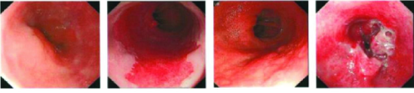
Grouping data
Barrett’s oesophagus
Oesophageal cancer
Healthy
No dysplasia
High-grade dysplasia
Low-grade dysplasia
Notes:
BRIANNA

Slide 16
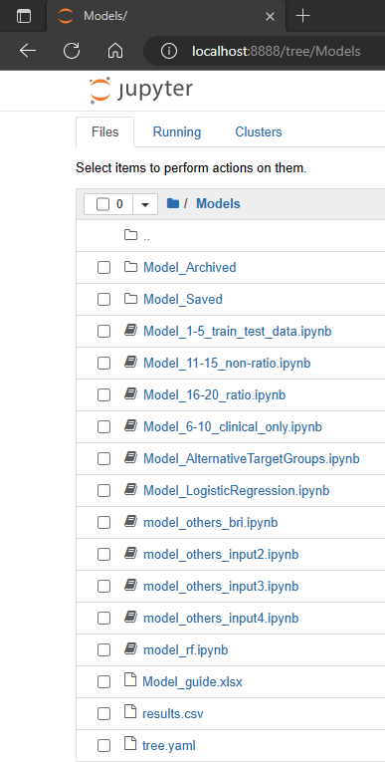
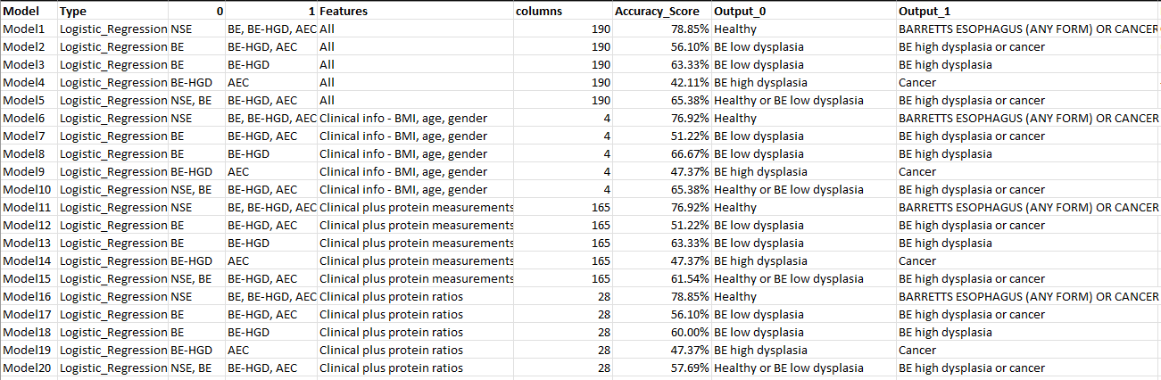
Supervised machine learning
Model guide:
Notes:
BRIANNA

Slide 17
The process
How do we optimise ML models?
Adjust the data going in
Adjust the targets to test for
Adjust the parameters for each model
Notes:
BRIANNA

Slide 18
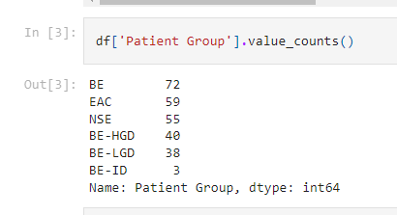
1. Data in
2. Target
There are four different presentations of this data.
All values
Clinical information only
Clinical information and protein measurements
Clinical information and protein ratios
There are multiple categories in the target column.
We need to group the targets to work with binary classifier models.
‘Healthy’ vs ‘the rest’
BE vs BE-HGD and cancer

Slide 19
3. Find the best parameters
Explored Logistic Regression, Decision Trees, Random Forest and SVM.
Create each model with parameter optimisation
Run each model with 4 inputs and test for 2 targets = 8 instances per model
Logistic Regression was also run without parameter optimisation for comparison
Notes:
BRIANNA

Slide 20
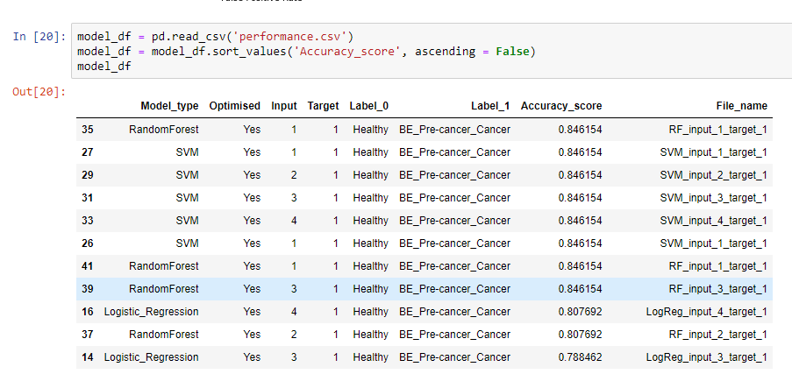
Performance of ML models

Slide 21
Front end: Streamlit
4
Notes:
ROB

Slide 22
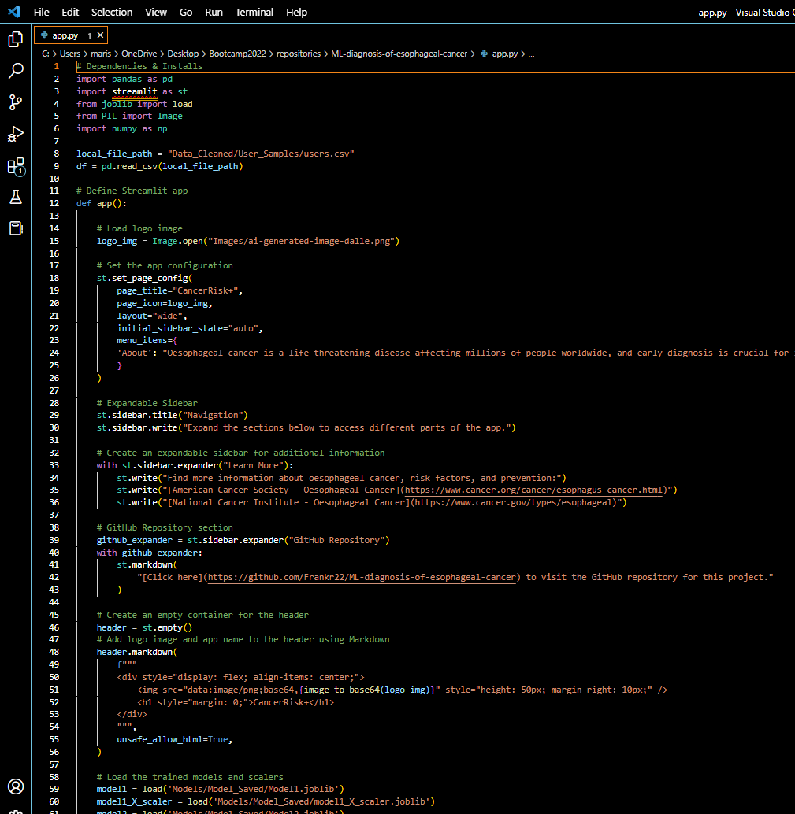
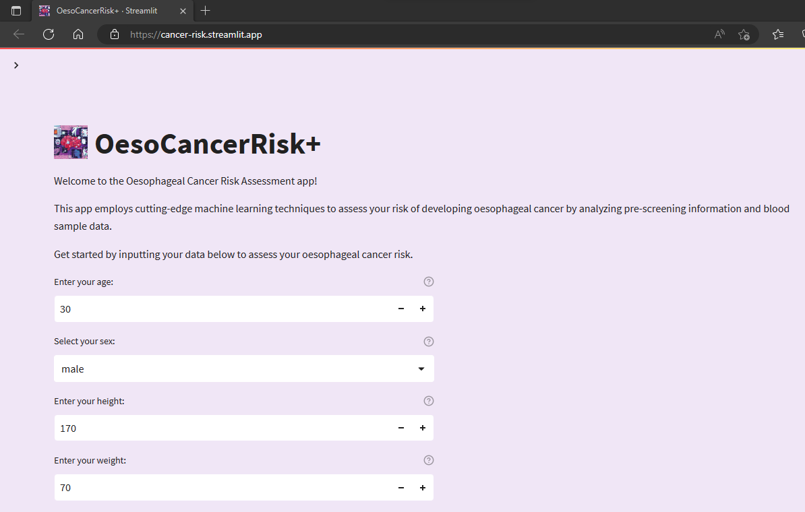
User friendly app interface to predict esophageal cancer
https://cancer-risk.streamlit.app/
Notes:
ROB

Slide 23
Limitations & Future Work
5
Notes:
ROB
Now for a look at the output - our interactive dashboard

Slide 24
Limitations
Small datasets (hundreds, US and AUS; not thousands, internationally):
49 + 252 data entries combined from 2 cohorts
– 10 samples taken out to test app
Limited age range in training model.
Need to use app with caution, talk to GP who understands the limitations of ML models.
When diagnosing cancer in Healthy individual, Barrett’s esophagus data is excluded in the ML model (ie. Assuming the person is confirmed healthy)
Future Work
Add more patients into training models
Optimise more models
Improved Data Storage
GitHub repository: https://github.com/Frankr22/ML-diagnosis-of-esophageal-cancer
Notes:
There’s opportunities for future development and expansion of this project, such as incorporating additional data sources or expanding the scope of the analysis.
For example useful mortgage delinquency data, inflation data, and other key macroeconomic housing market indicators
Improved layout css and html
Time consuming,
More interactivity
Database setup
The current setup uses SQLAlchemy as the Object Relational Mapper (ORM) to interact with a remote database hosted on Amazon Web Services (AWS). The database username and password are stored in a gitignore file (console.py) to protect sensitive information.
A simpler and more straightforward solution, would be to switch the database to a local SQLite database that is stored as a file on the user’s local machine. The SQLite database does not require a remote connection or authentication, so there is no need to store the database credentials in a separate file.
With the current setup, the database is hosted remotely on AWS and requires a connection over the internet, which can be slower and more susceptible to network issues. With the SQLite option, the database is stored locally on the user's machine, which allows for faster access times and eliminates the need for a remote connection.

Slide 25
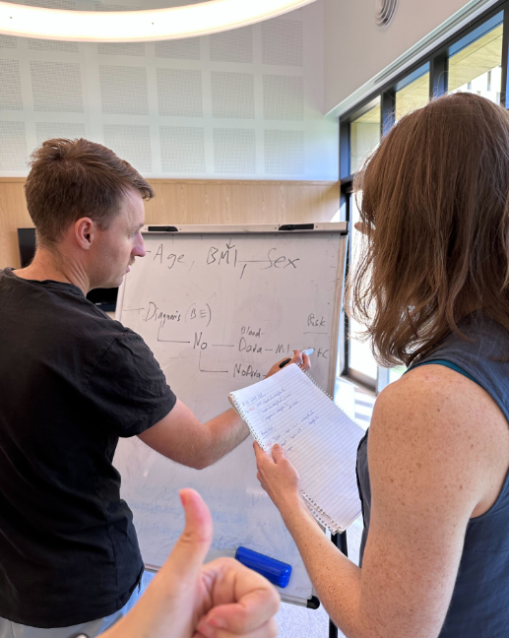
Q&A
Notes:
That’s the end of our presentation, so now we’ll open up to some questions.

